Slide 1
Mobile price prediction
By: Mohamed atef

Slide 2
Content
Data Preprocessing
Exploratory Data Analysis
Data visualization
Feature Selection
Choosing best ML algorithm
Deployment

Slide 3
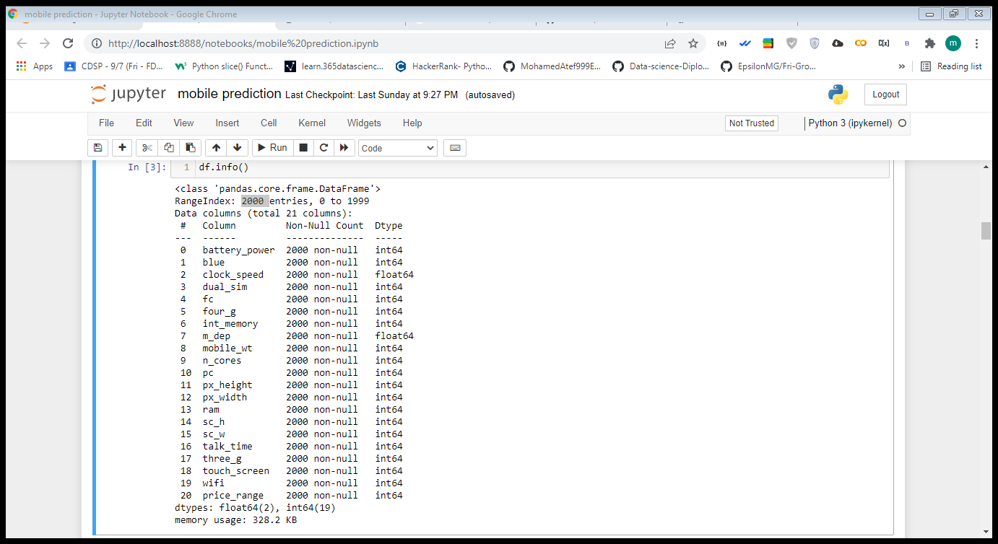
Task Description
This dataset gives 2000 different mobiles basic information

Slide 4
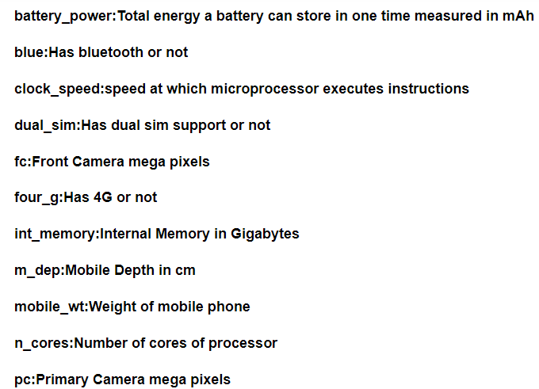
Dataset Description

Slide 5
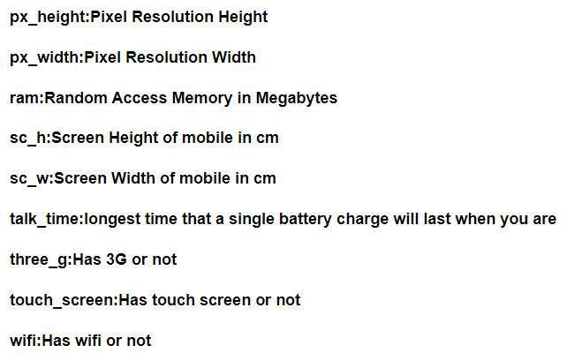
Dataset Description

Slide 6
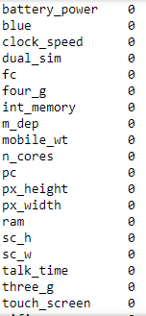
Data Cleaning
Removing Null Values

Slide 7
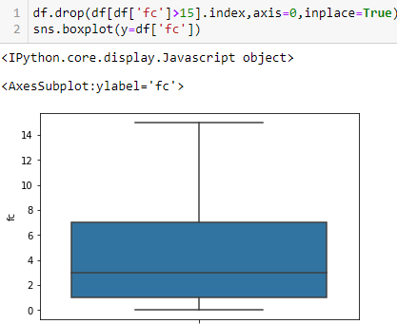
Data Cleaning
Detecting outliers

Slide 8
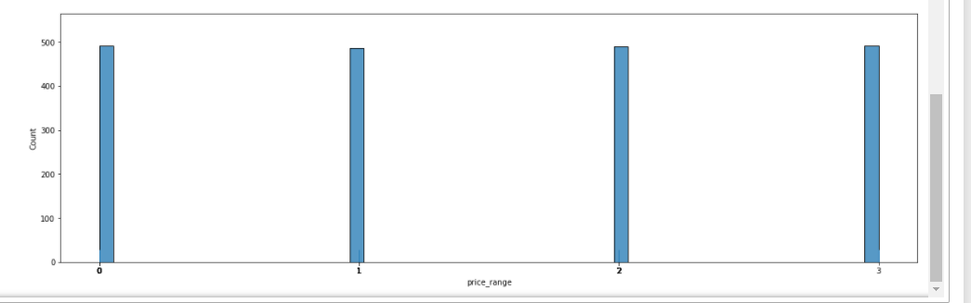
Data visualization

Slide 9
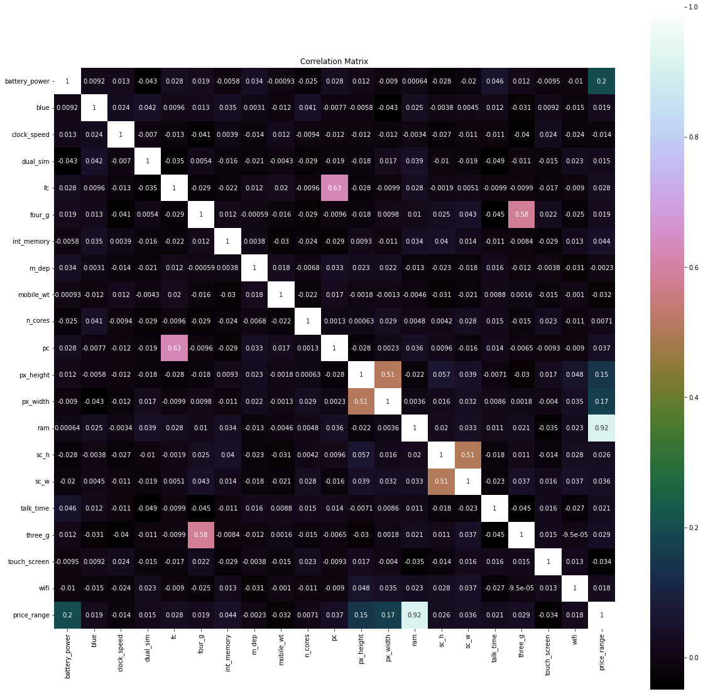
Data visualization

Slide 10

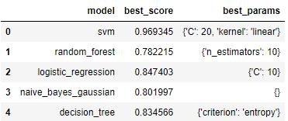
Choosing best algorithm

Slide 11
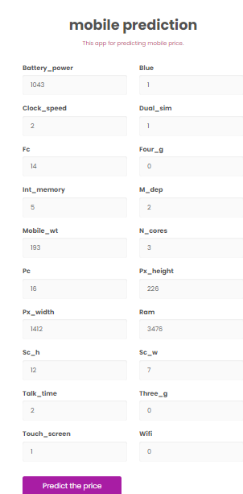
Deployment with flask

Slide 12
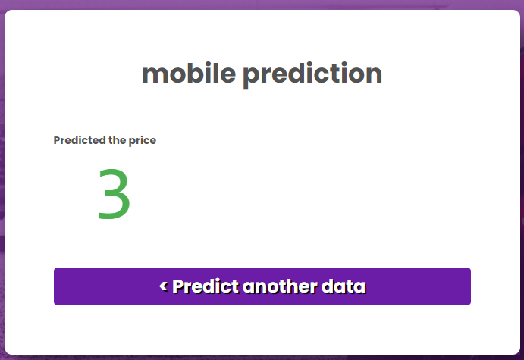
Finally

Slide 13
Thank you

